Slide 1
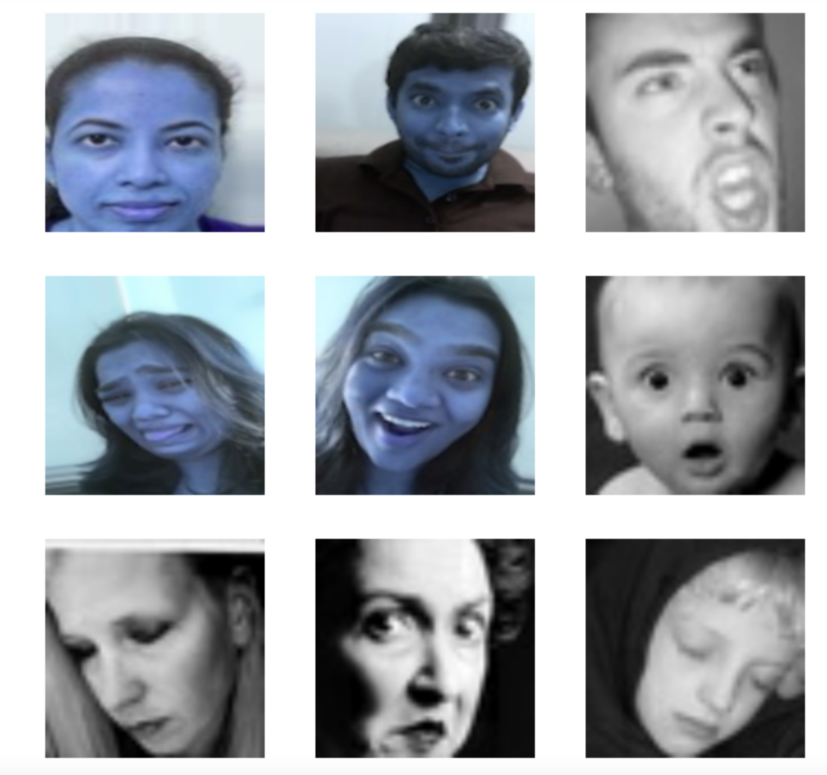
BAN693 Capstone Project
FACIAL EMOTION RECOGNITION USING DEEP LEARNING
Under the guidance of Dr. Chongqi Wu
Team:
Anjul Jain
Kavya Pothula
Manushree Sannathimmappa
Uttara Dabbiru

Slide 2
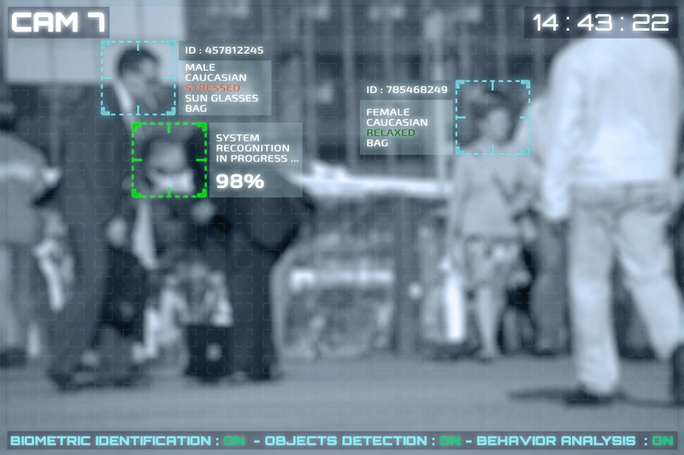
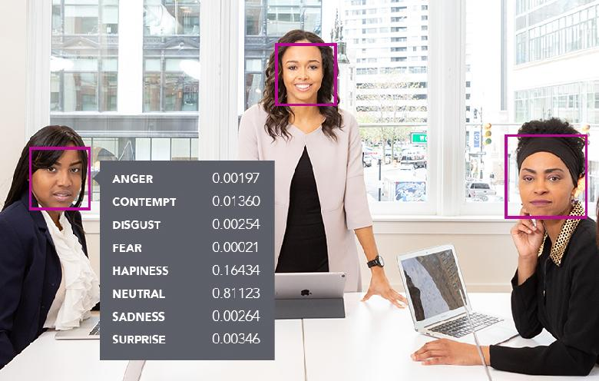

Objective
What is FER?
Why we are working on this problem?
How we are implementing? - Deep Learning
Applications of FER

Slide 3

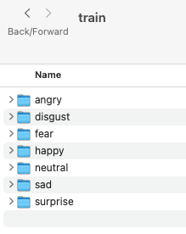
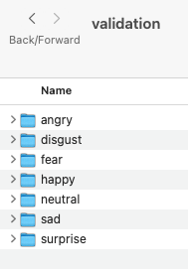
Kaggle and custom data set
Data Overview
Data Pipeline
Data Collection

Slide 4
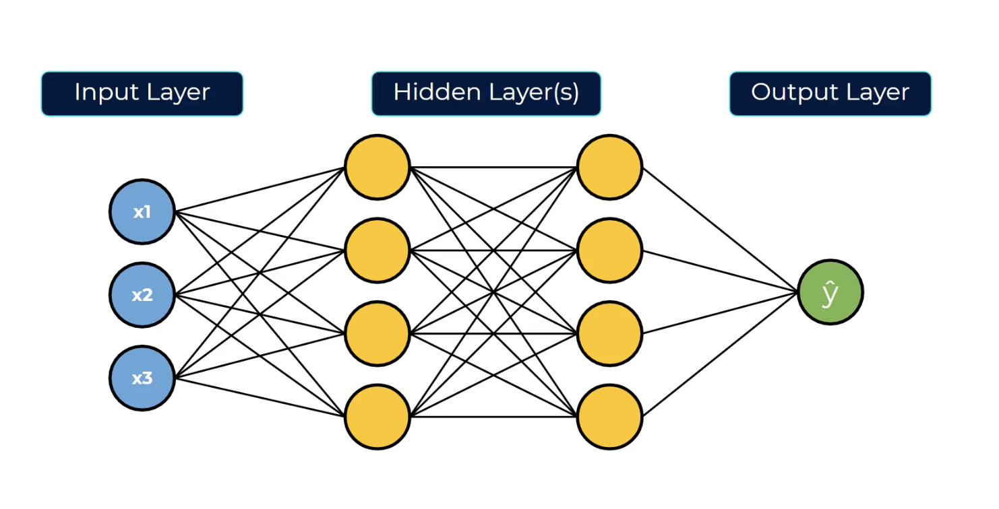
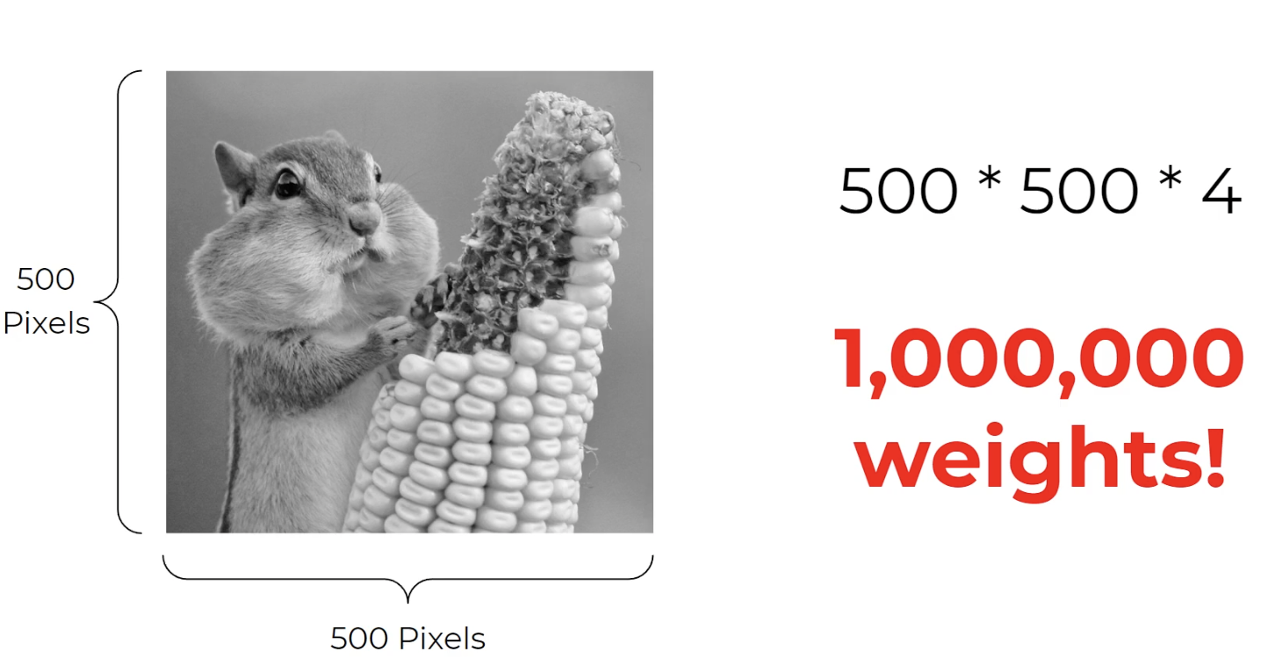
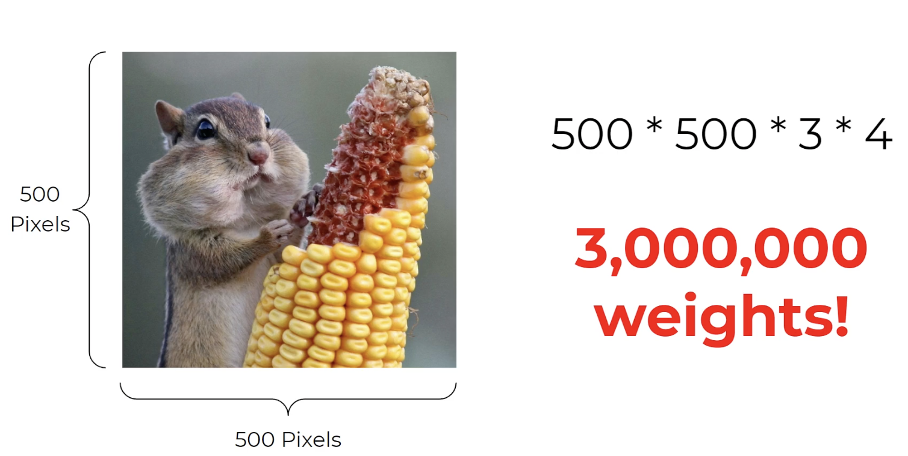
Artificial Neural Network

Slide 5
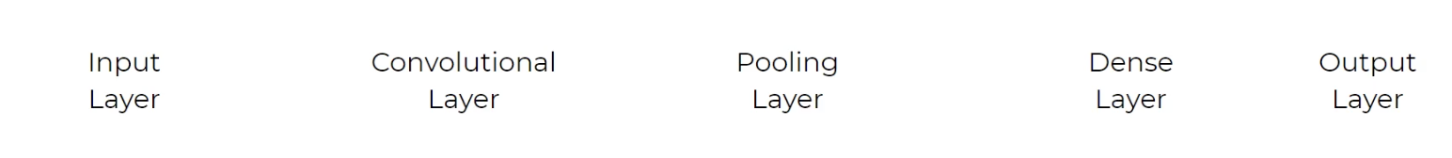

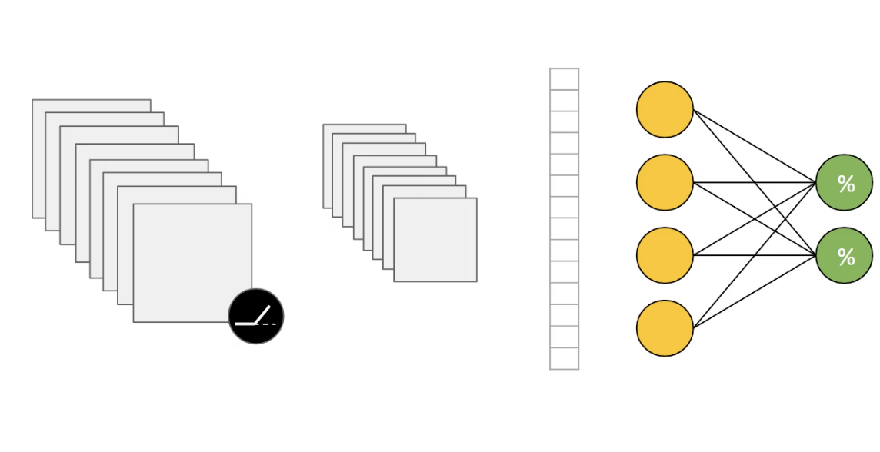

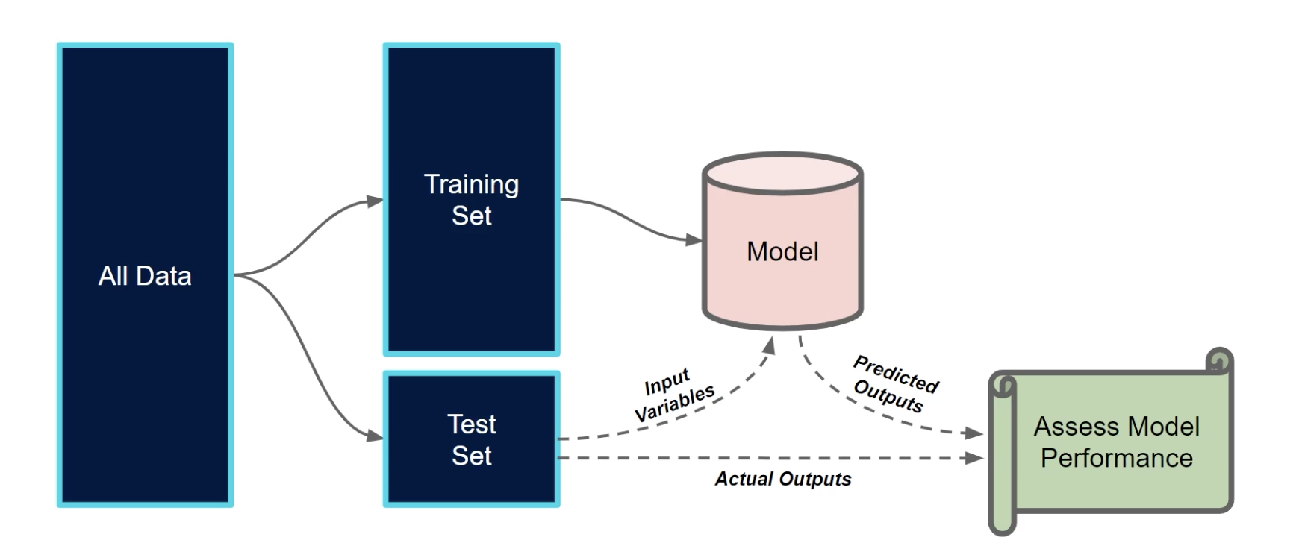
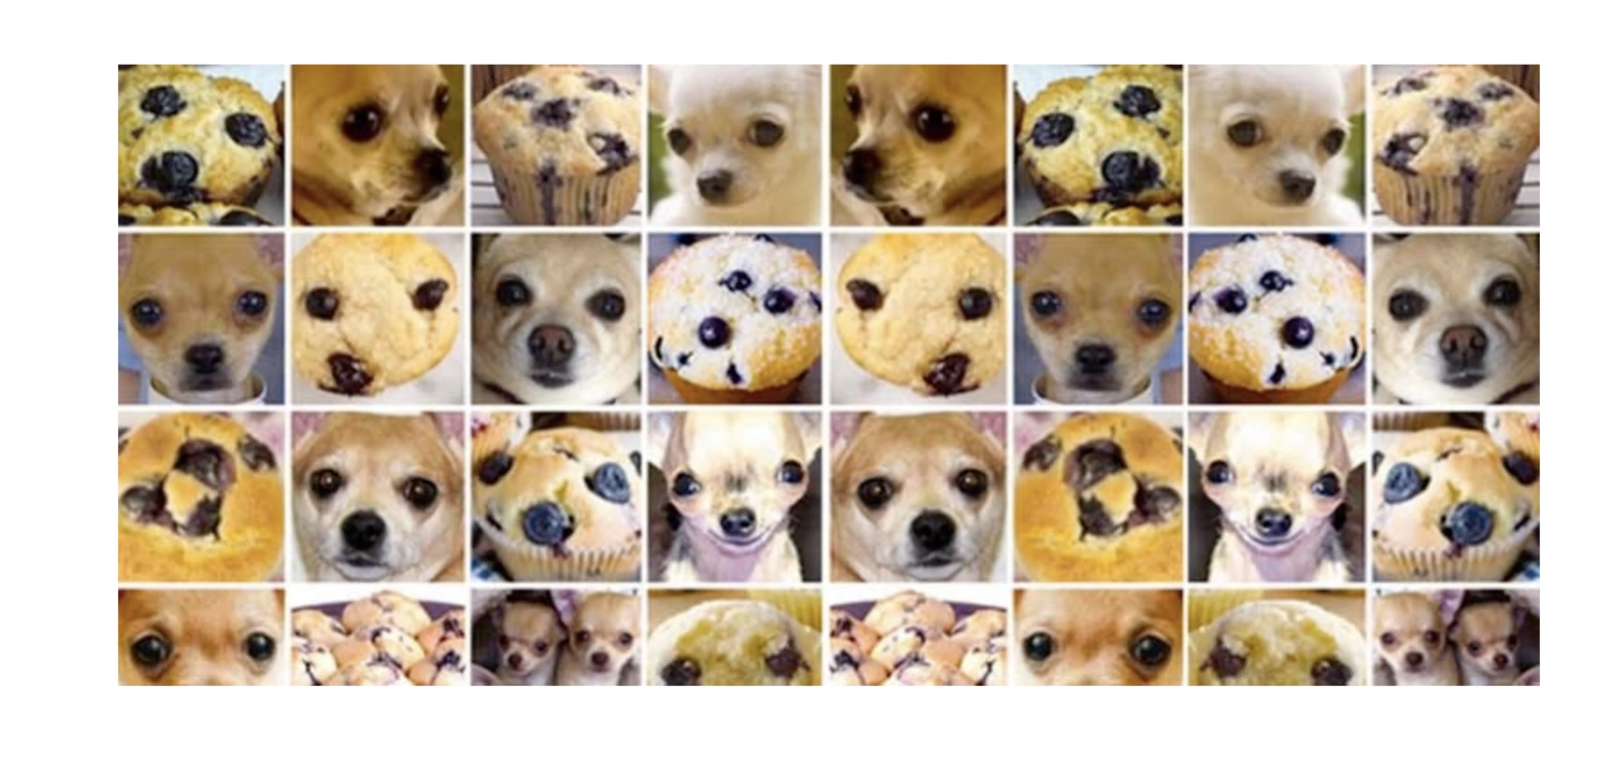
Convolutional Neural Network
Overview
Why CNN
CNN as a Baseline n/w
N/w Architecture
Training the network
Analysis of Results
Tackling Overfitting
“Happy”
“Sad”

Slide 6
Model Validation

Slide 7
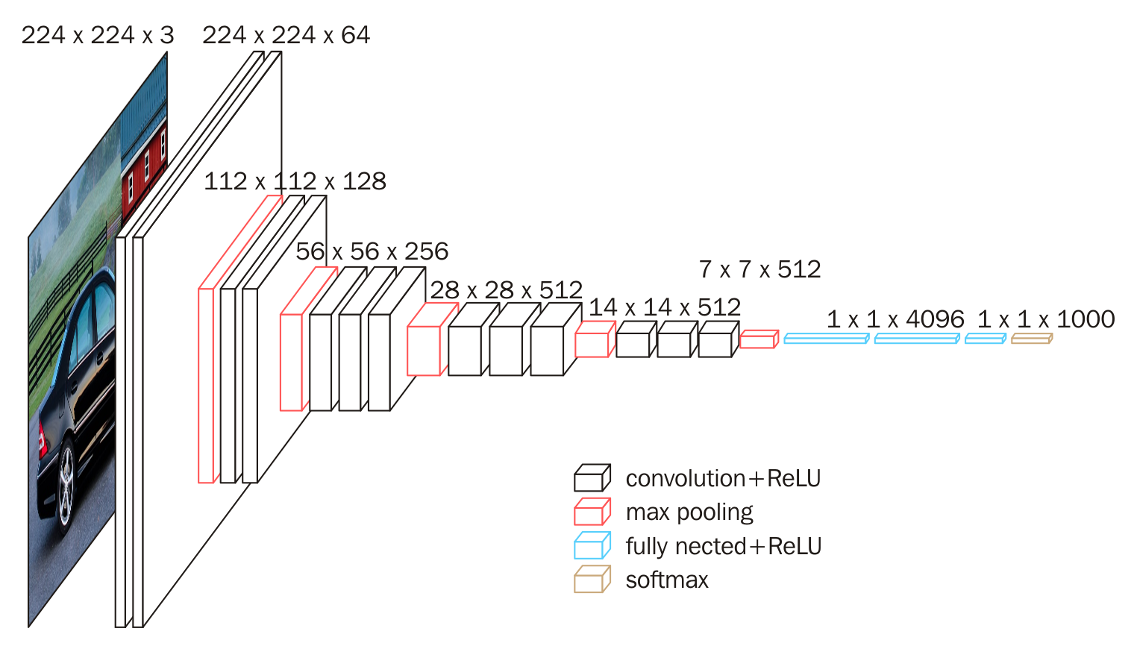
Transfer Learning
What & Why Transfer Learning?
Training the updated network

Slide 8
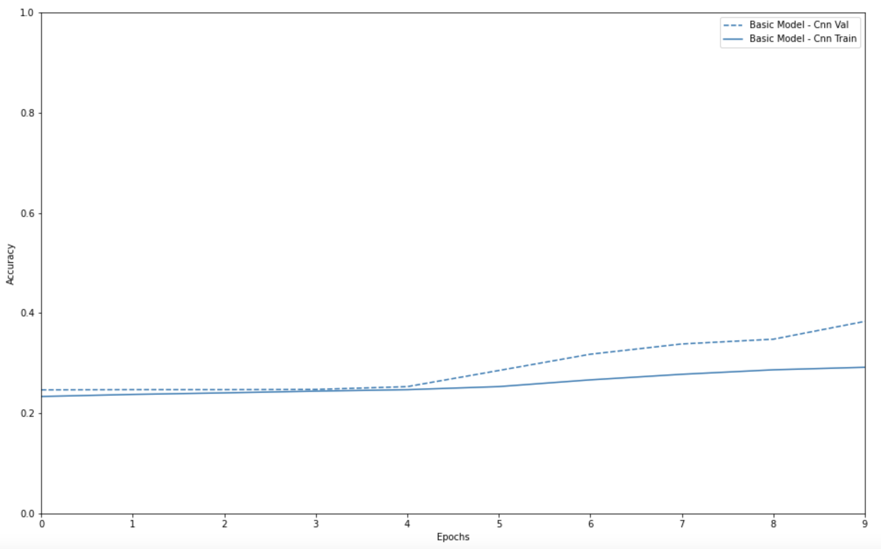
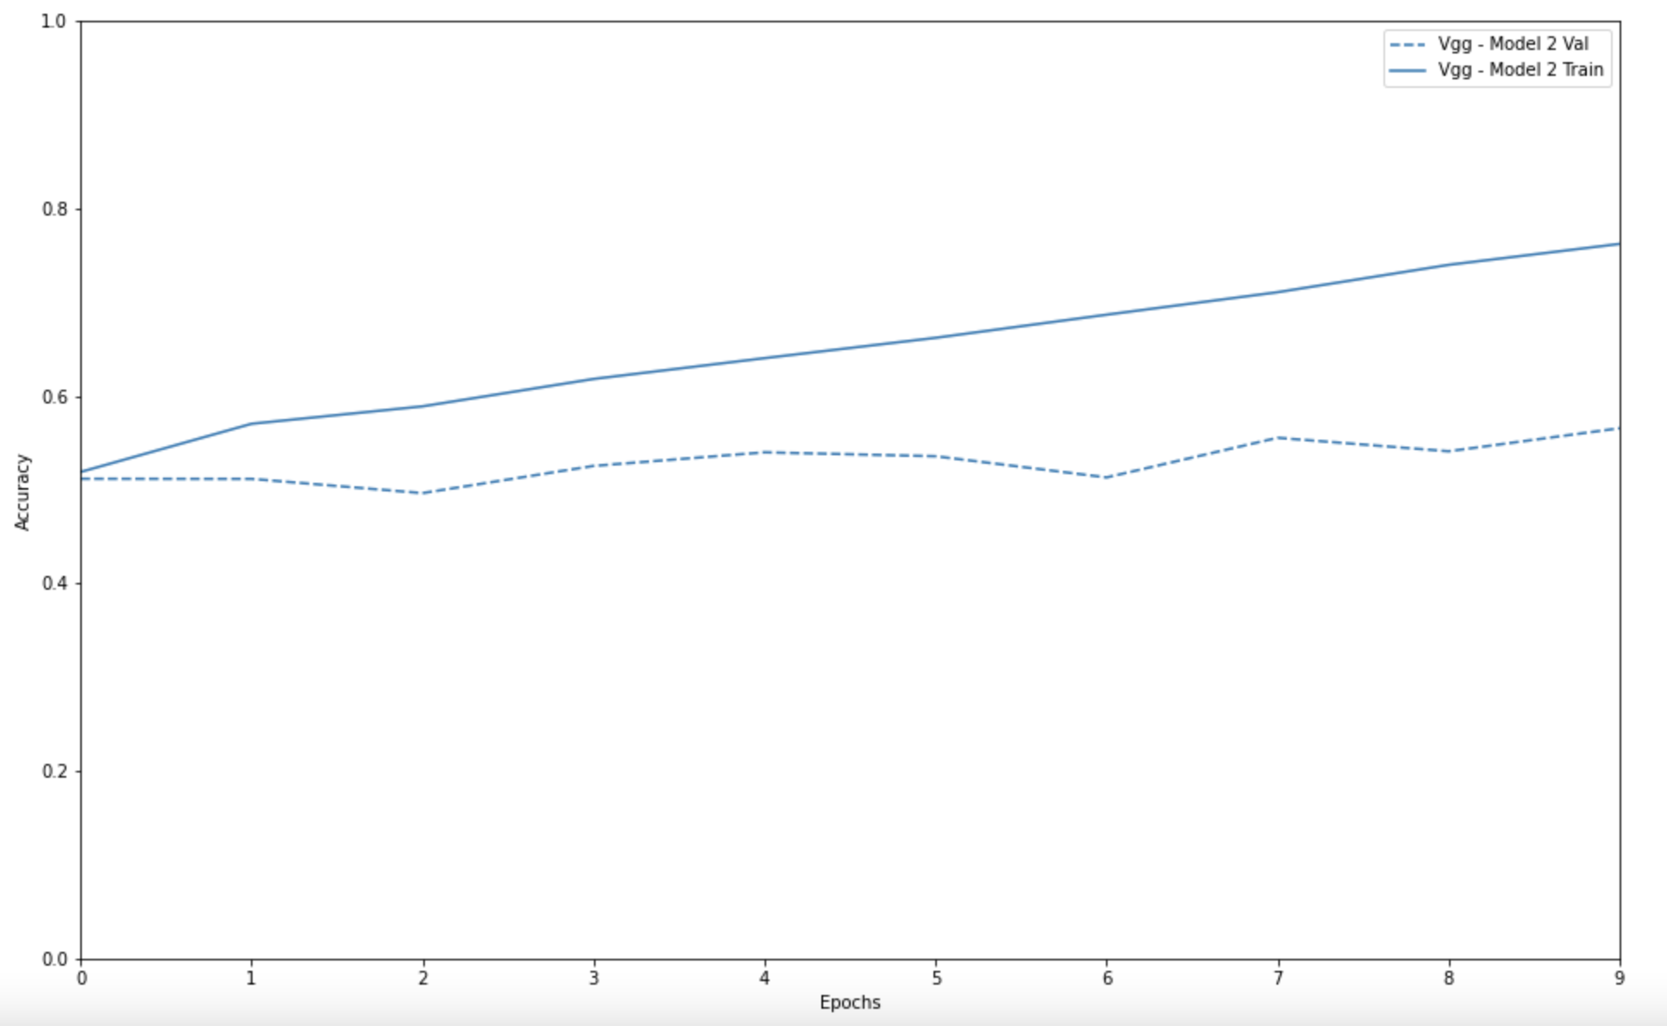
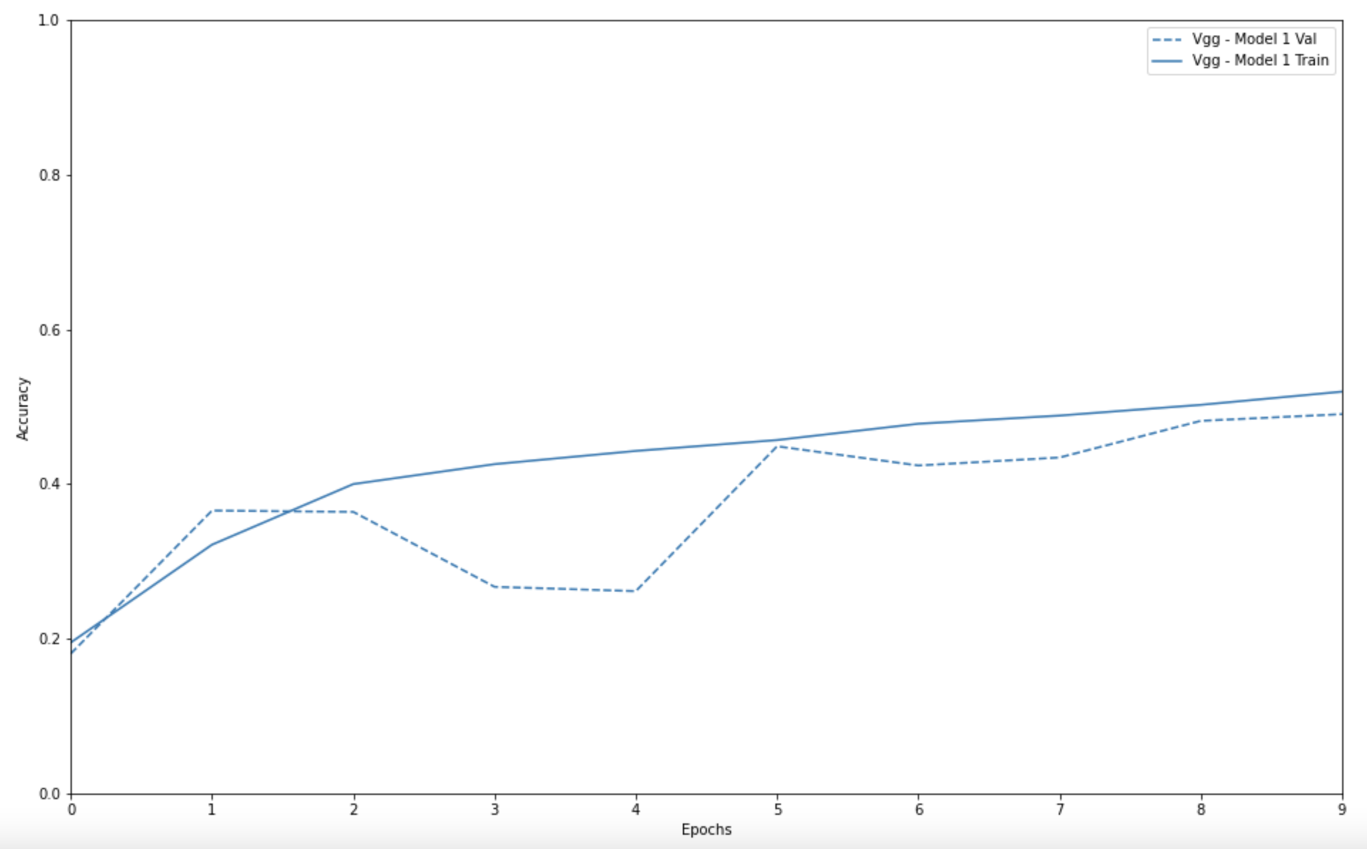
Model Selection
Classification Accuracy | CNN | VGG-1 | VGG-2
Training Accuracy | 29% | 52% | 76%
Validation Accuracy | 38% | 49% | 57%

Slide 9
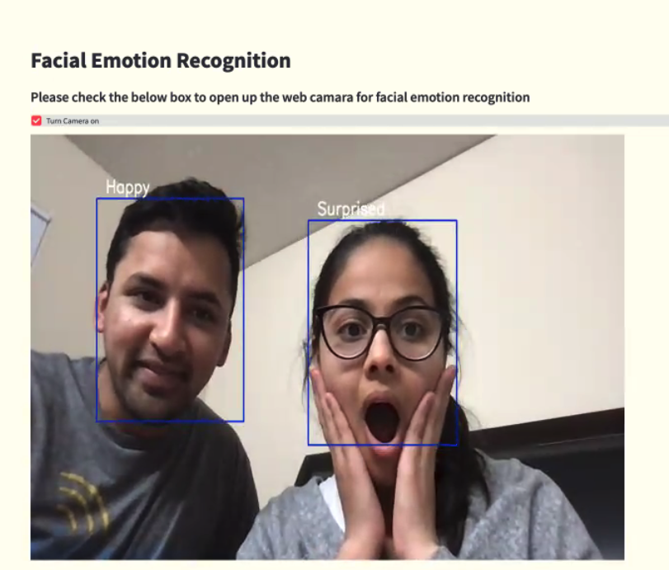
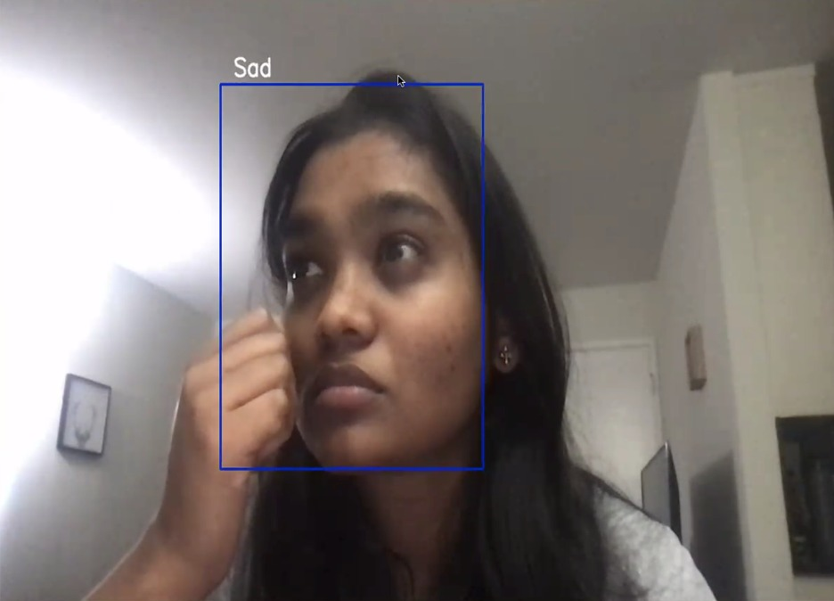
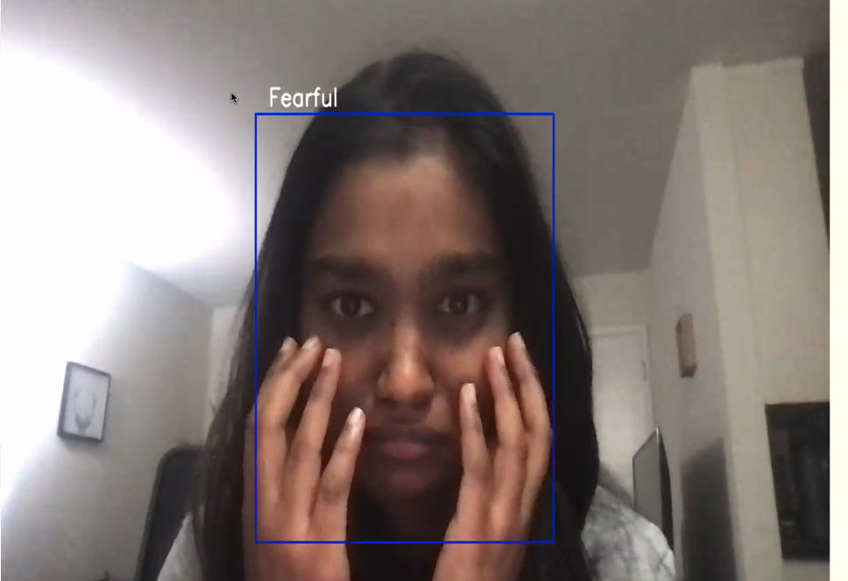
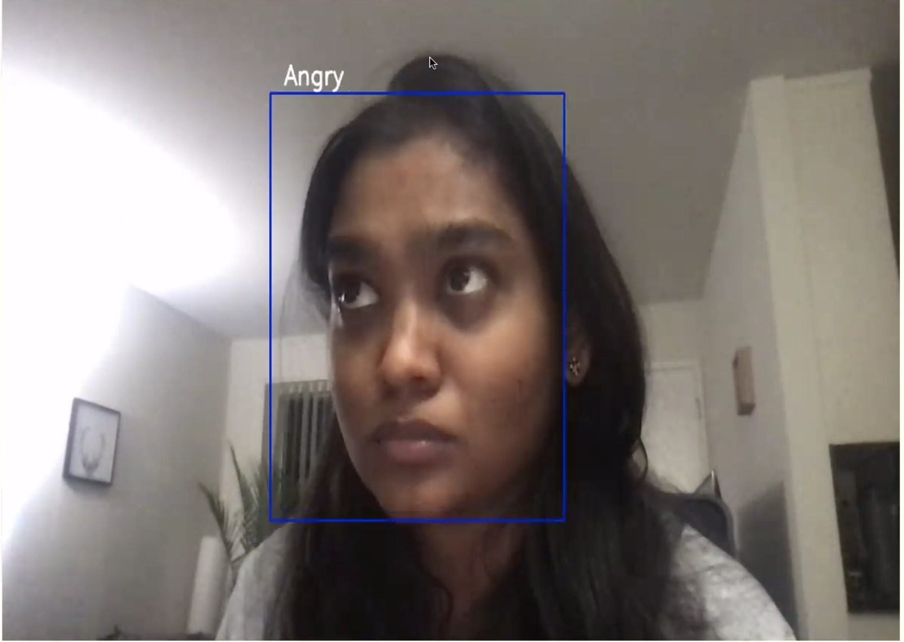
Let’s recognize the emotions…

Slide 10
Thank you! Open for Questions . . .

Slide 11
